Slide 1
Revisiting Single Image Reflection Removal In the Wild
Yurui Zhu^{1, 2, *} , Xueyang Fu¹, Peng-Tao Jiang²,
Hao Zhang², Qibin Sun¹, Jinwei Chen², Zheng-Jun Zha¹, Bo Li²
¹University of Science and Technology of China ²vivo Mobile Communication Co., Ltd
Computer Vision and Pattern Recognition Conference 2024 (CVPR2024)
Group No. 11
313551088 楊右宇 Yu-Yu Yang,
313551072 郭建廷 Jian-Ting Guo,
313551019 羅凱威 Kai-Wei Luo
Notes:
Hello everyone, we are Group 11. My name is 楊右宇, and my teammates are 郭建廷 and 羅凱威. The paper we are going to present is titled 'Revisiting Single Image Reflection Removal in the Wild,' from CVPR 2024.

Slide 2
Outline
Introduction
Related Work
Revisit Reflection Physical Formulation
Method
Experiments
Conclusion
Notes:
This slide provides an overview of our presentation, covering the introduction, related work, the Reflection Physical Formulation, method, experiments, and conclusion. Now, let's start with the introduction.

Slide 3
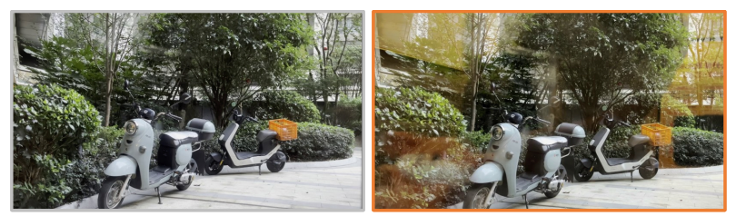
Introduction
Reflections caused by glass and other reflective surfaces degrade image quality.
Transmitted Light Image
Reflection Images
Notes:
This study focuses on removing reflections from single images captured in real-world conditions. Reflections, often caused by glass or other reflective surfaces, degrade image quality and affect subsequent computer vision tasks.

Slide 4
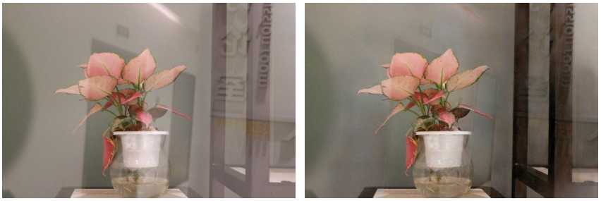

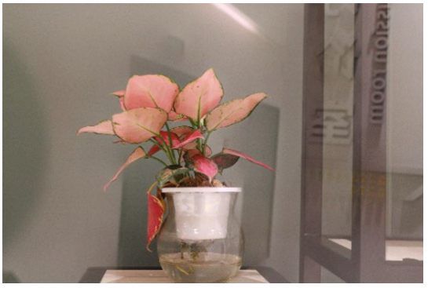
Introduction
Existing methods have limitations in complex real-world scenarios.
Reflection-
contaminated image
Output Result by
Previous Methods
(IBCLN)
Transmission layer
(Ground Truth)
Output Result by
Previous Methods
(DSRNet)
Notes:
Existing methods struggle with accuracy in complex scenarios. The top-left image shows a photo with reflections, while the bottom-left image represents the desired outcome. The two images on the right show the results of other studies, and compared to the ground truth, you can see noticeable artifacts within them.
Another issue is that training such models requires collecting datasets. Current data collection methods are either very costly and cumbersome, or they fail to accurately replicate real-world scenarios.
This study aims to improve accuracy and generalization while reducing costs.

Slide 5
Related Work
Traditional Methods:
Utilized features and prior knowledge.
Relied on assumptions about reflection characteristics.
Deep Learning Methods:
Employed neural networks for direct prediction.
Improved accuracy and robustness.
Hybrid Approaches:
Combined traditional priors with deep learning.
Used multi-stage models to guide and enhance the process.
Notes:
Traditional methods relied on prior knowledge to design algorithms, but they often struggled to work across all scenarios.
With the rise of deep learning, researchers began using neural networks to directly predict the transmission layer, offering better results and stability compared to traditional methods.
Recent studies have attempted to utilize prior knowledge to design specific features and employ multi-stage systems to guide the model.

Slide 6
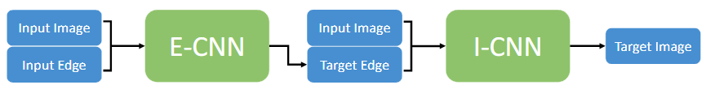
Related Work
CEILNet[5] adopts a two-stage network approach, which first estimates the edge map and subsequently reconstructs the transmission layer.
LANet[4] improve results by emphasizing strong reflection boundaries with Laplacian features.
Architecture of CEILNet
Notes:
CEILNet utilizes a two-stage model architecture. In the first step, the model uses the original image and its edge information to predict the edges of the transmission layer, and then reconstructs the transmission layer.
LANet incorporates LSTM into the model, simultaneously predicting both the transmission layer and the reflection layer. It improves the results by enhancing the reflection boundaries using Laplacian features.
Other related studies follow a similar approach. They try to leverage the transmission layer or reflection layer from the training data pairs to calculate different features. These studies use multi-stage models that first predict this information and then use it as additional inputs during the final restoration process to better guide the restoration of the transmission layer. This raises a new question: What kind of information is beneficial for predicting the transmission layer? And how should we process this information and incorporate it into the training process?

Slide 7
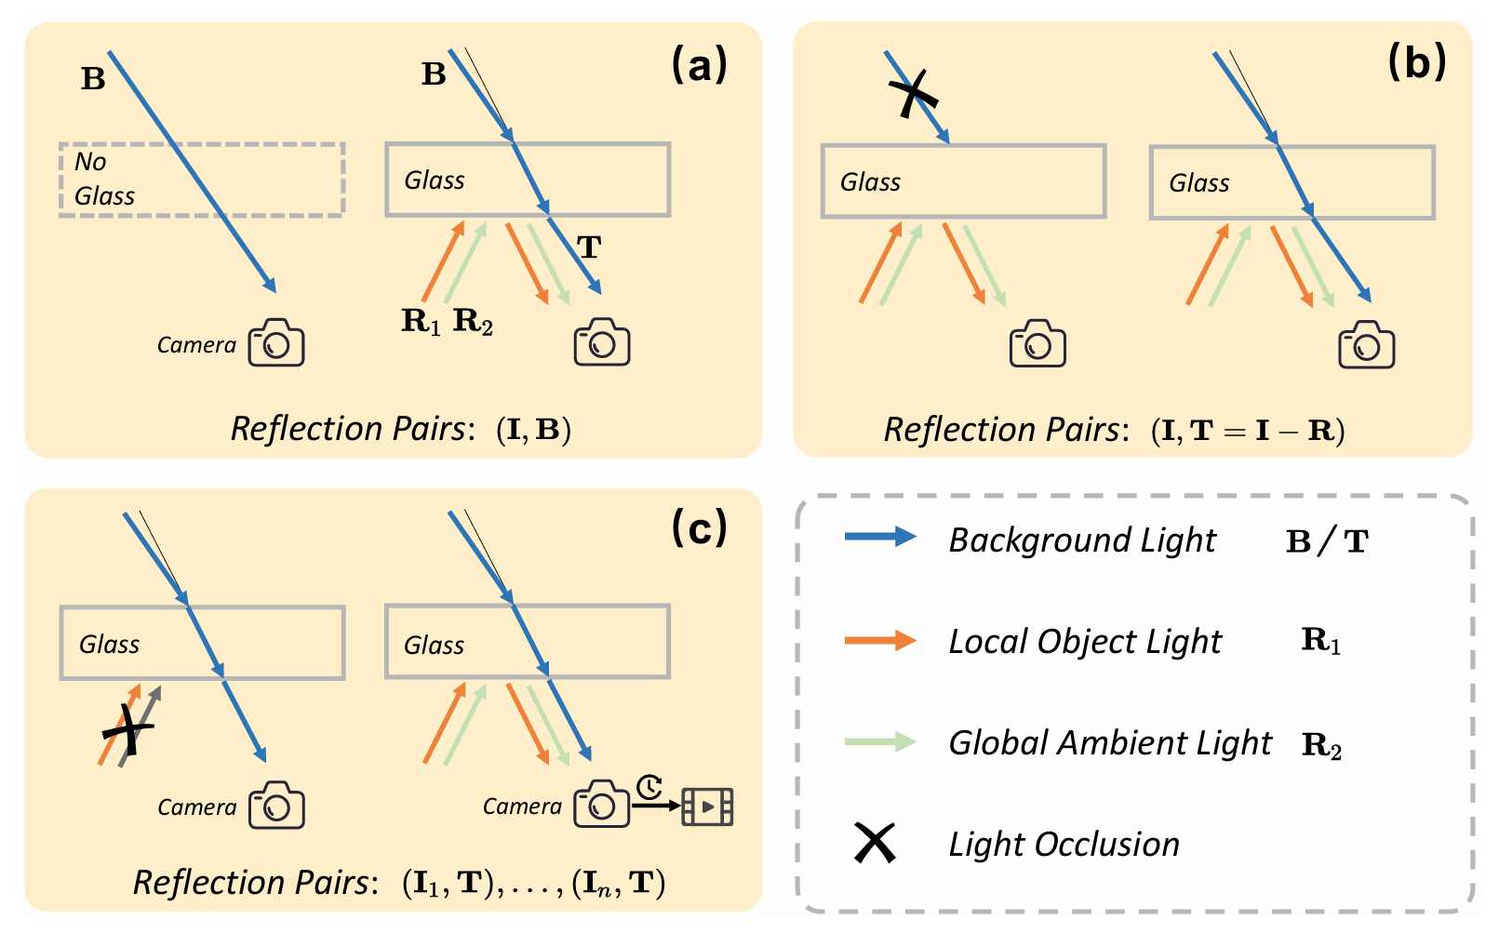
Revisit Reflection Physical Formulation
Reflection-contaminated image I = Reflection layer R + Transmission layer T
Transmission layer T = Glass(Background light B)
Reflection layer R = Local Object Iight R₁ + Global Ambient light R₂
Notes:
fa ci li tate ˇ-ˇˇ-
This section defines each type of light clearly to facilitate smoother discussions.
The reflection-contaminated I, typically the input for Single Image Reflection Removal (SIRR), is composed of a mixture of reflected light R and transmitted light T.
The transmitted light T, typically the expected output for SIRR, comes from the background light B behind the mirror. As the background light passes through the mirror, it undergoes refraction.
The reflected light R is generated by light sources on the camera’s side and consists of two parts:
1. The first part R1 is a virtual contents formed by the reflection of local object light, usually occupying only part of the image. This reflection can occlude or overlap with the transmitted light.
a ten u ation
2. The second part R2 is caused by the reflection of global ambient light, leading to attenuation of the image’s overall color and contrast.
(Since the local object light only exists in certain areas, removing it is more challenging. Therefore, this paper proposes MaxRF to capture the reflection positions of the local object light.)

Slide 8
Method
Data Collection Pipeline
Maximum Reflection Filter (MaxRF)
Network Architecture
Notes:
After defining the different types of light, we then move on to the methodology.
First, I will discuss the data collection pipeline, followed by Jianting, who will cover MaxRF and the network architecture.

Slide 9
Data Collection Pipeline
(a) [19, 39, 53] manually remove the glass.
Do not count the refraction and color changes.
May lead pixel misalignment and color distortion.
(b) [15, 16] block B to obtain R. Then produce T through T = I - R.
Based on the observation of the linear physical composition in RAW data.
Notes:
First, in data collection, we need to capture an image containing reflections as the model’s input and an image without reflections as the output, referred to here as a reflection pair.
References \[19, 39, 53\] obtain the reflection pair (I, B) by capturing images with and without the glass in place, as shown in image a.
First, they capture an image I with reflections. Then, after removing the glass, they capture an image containing only the background light B. This pair (I,B) is used as the reflection pair.
However, this method do not account for refraction and color changes that occur when light passes through the glass.
As a result, when the glass is thicker or colored, it leads to pixel misalignment and color distortion.
The misalignment makes subsequent network training more difficult \[15\], and the color distortion limits the applicability of this data collection method.
References \[15, 16\] simply capture a reflected image I, and block the background light B to obtain the reflected light R. Then, they obtain the transmitted light T by subtracting the reflected light R from I, which is based on the observation of the linear physical composition in RAW data, and use (I,T) as reflection pairs.
This approach requires collecting data in RAW format, and the resulting data may still contain subtle reflection artifacts.

Slide 10
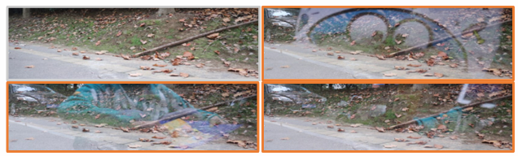
Data Collection Pipeline
This study block the reflection layer R from camera side to obtain transmission layer T.
This study collects data by recording videos.
Notes:
This study uses a black velvet cloth to block the reflected light R from the camera’s side, ensuring that the camera captures a clean transmitted image T. It also captures the reflection-contaminated image I, forming the reflection pair (I,T).
Unlike previous method, this approach directly captures the transmitted light T without relying on RAW format.
Additionally, this paper collects data through video recording.
After capturing a clean transmitted image T, as shown in the top-left image, the scene is actively adjusted to create varied reflective environments, such as blocking part of the reflective light source or adding/removing reflective objects, as seen in the other three images. This allows multiple reflection-contaminated images I to share the same clean transmitted image T as the ground truth.

Slide 11
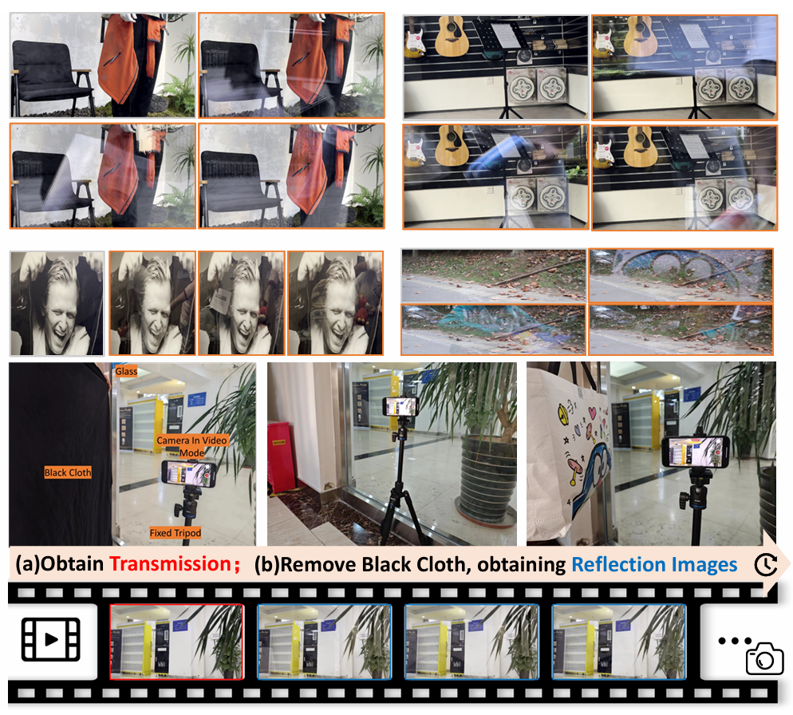
Data Collection Pipeline
This study present a large-scale high-quality paired reflection dataset, Reflection Removal in the Wild (RRW).
RRW contains a total of 14-952 reflective pairs—45 times more than the previous real-world dataset.
Notes:
This study present a large-scale high-quality paired reflection dataset, Reflection Removal in the Wild (RRW)
They collected a total of 14,952 high-resolution reflective pairs, which is 45 times larger than the previous real-world reflective pair dataset.

Slide 12
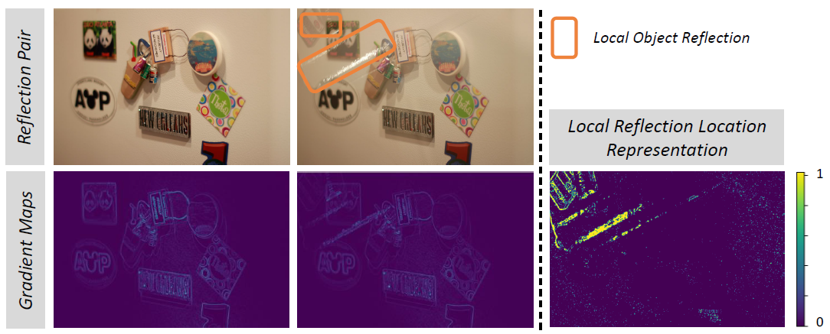
Maximum Reflection Filter (MaxRF)
MaxRF involves two key steps
Apply Sobel operator [6] to compute gradient maps for both images.
Perform maximum comparisons in the corresponding gradient domain.
Visualization of the reflection via proposed MaxRF
Notes:
to remove the local object reflection…

Slide 13
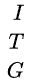
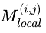

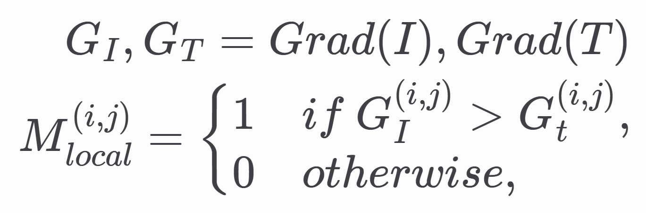
Maximum Reflection Filter (MaxRF)
: Reflection-contaminated image
: Transmission image
: : Gradient-map
: Sobel operator
: Mask ground-truth
MaxRF formula
Gradient-map

Slide 14
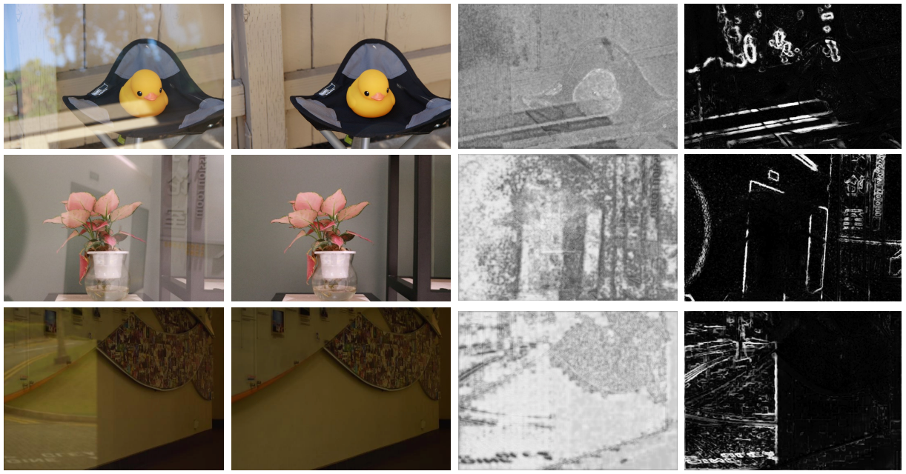
Ablation Study (reflection location visualization)
reflection images
reference images
LANet
this study

Slide 15
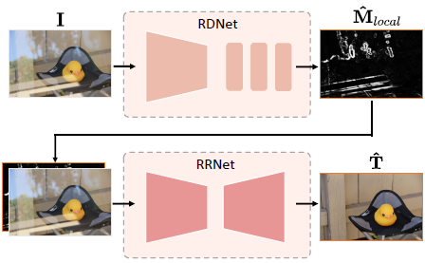
Network Architecture
Two-stage network structure
RDNet use pretrained EfficientNet-B3 [38] and several Residual Block [8]
RRNet use NAFNet [3]
two-stage network structure

Slide 16
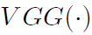
Network Architecture
RDNet Loss function
RRNet Loss function
: indicates hierarchical features
extracted by conv1_2,conv2_2,conv3_2,conv4_2 of the VGG19

Slide 17
Experiments
Training Data: Combined previous datasets [4, 9, 10, 19] with RRW (this study).
Testing Datasets (real world): Real, Nature (train/test), SIR2 (test only).
Metrics: PSNR, SSIM in RGB.
SOTA Comparison: pre-trained weights, same inputs, same evaluation codes.
Adjustments: fine-tuning for methods [11, 46] since they were developed before the Nature dataset was available.
Notes:
In the experiments, this study trained the models using a combination of previous datasets and the newly proposed RRW dataset.
For testing, the models were evaluated on three real-world datasets: the Real dataset, the Nature dataset, and the SIR2 dataset.
Performance results were assessed using PSNR and SSIM metrics.
To ensure fair comparison with state-of-the-art methods, pre-trained weights released by the original authors were used, along with the same inputs and evaluation codes.
Additional fine-tuning was performed on a few methods, as they were developed before the release of the Nature dataset.

Slide 18
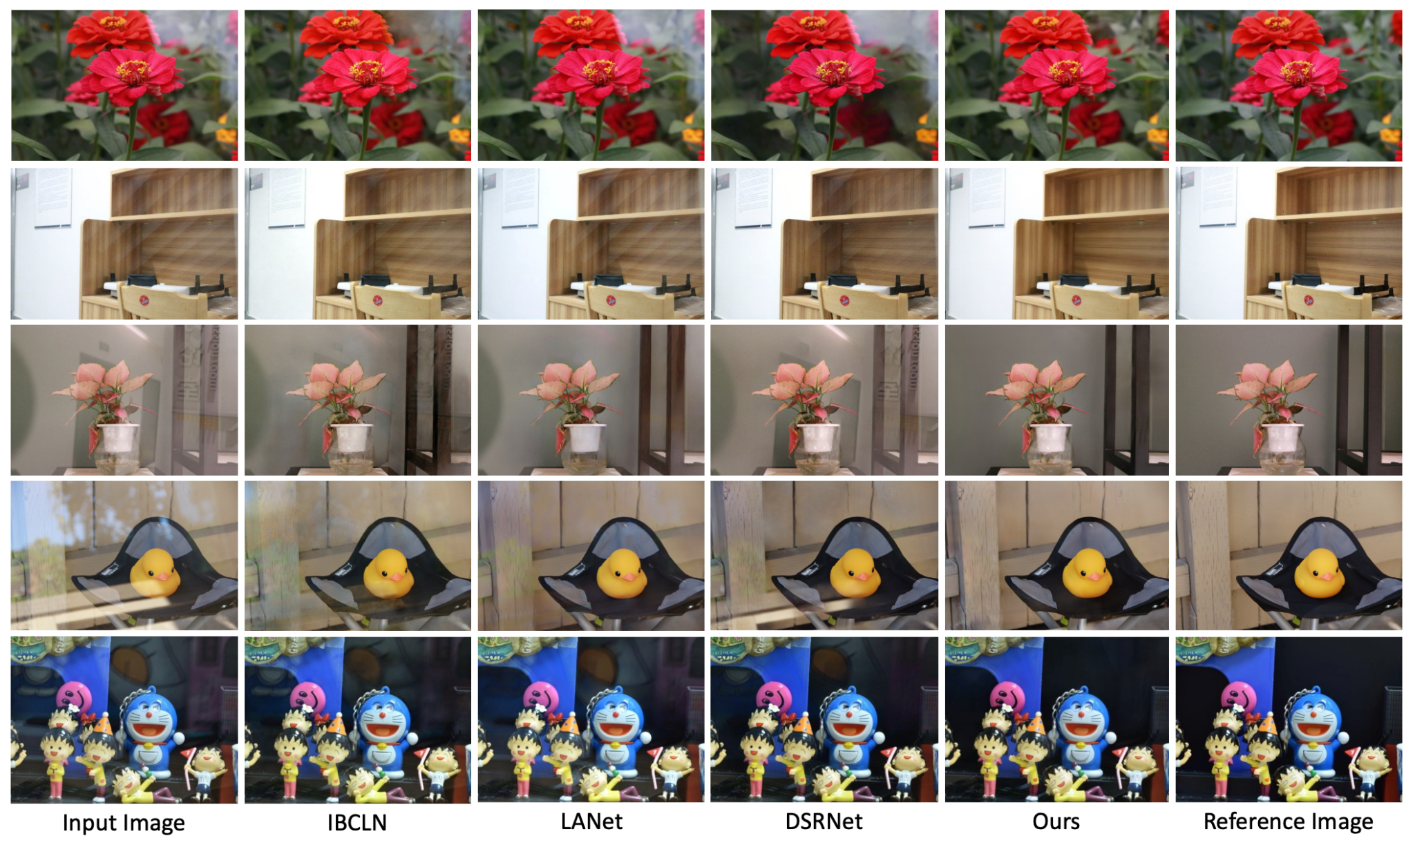
Visualization
Input Image
IBCLN
LANET
DSRNET
This Study
Reference Image
Notes:
This is a comparison of the results. Let's focus on the middle row for comparison. In this study‘s result, the residual reflection of the door behind the flowers and the outlines of the text have been successfully removed.

Slide 19
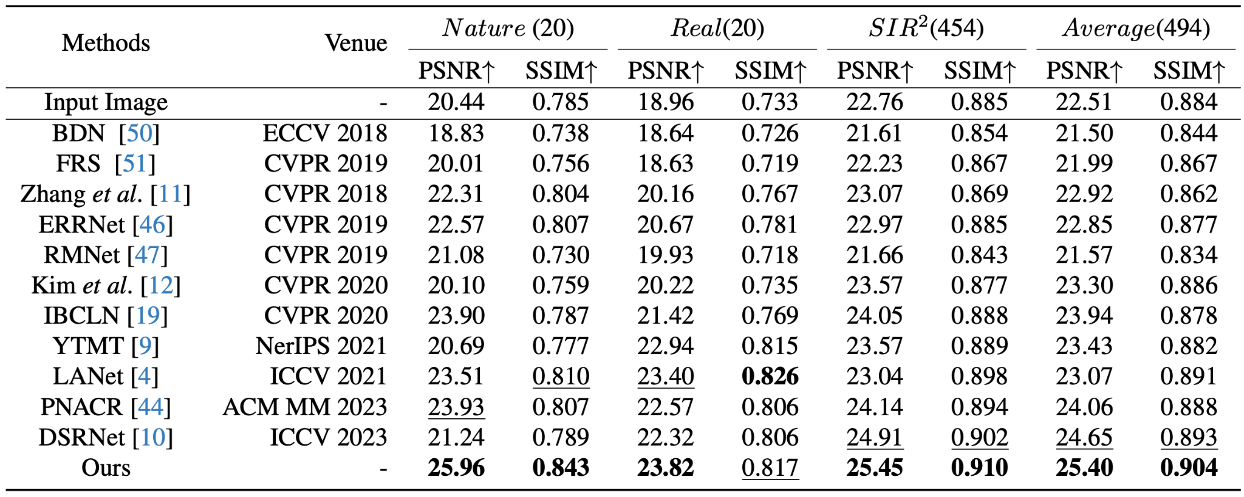
Experiments
Notes:
In terms of the scores, this study's results are mostly ranked first, with only one metric where it ranks second.

Slide 20
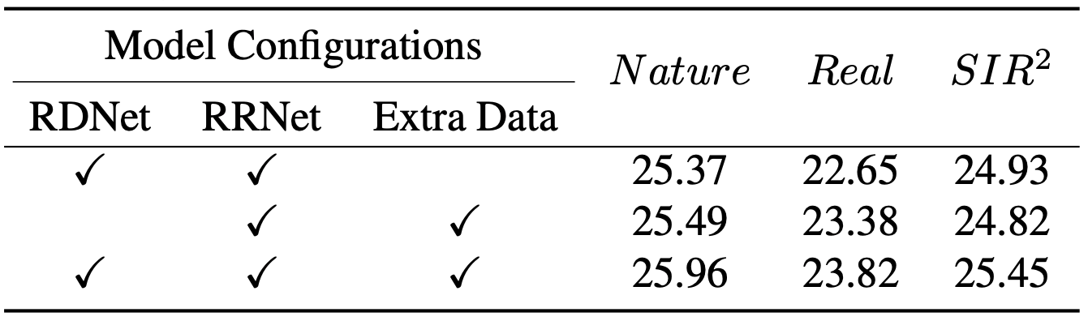
Ablation Study (Component Analysis of This Study's Framework)
Notes:
This experiment compares the ablation study of two components in the system, and the results indicate that using both techniques yields better performance.

Slide 21
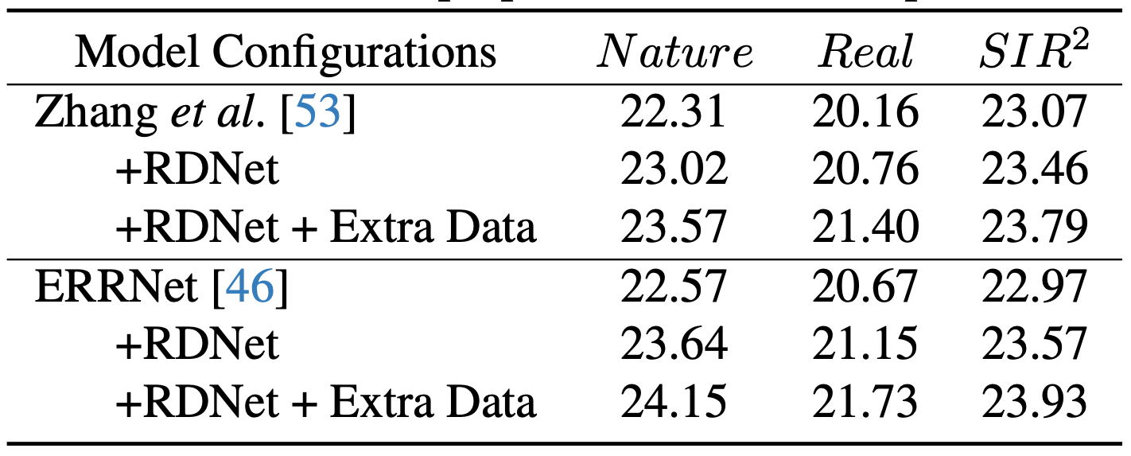
Ablation Study (Extension of Proposed Innovations)
Notes:
Another ablation study, which we found especially interesting, involved applying the two components to different research methods. The results showed improved scores compared to those in the original papers, suggesting that the authors' approach may offer broader applicability.

Slide 22
Conclusion
Revisited the physical process of reflection degradation in images.
Proposed a new pipeline for real-world reflection data collection, creating the RRW dataset.
Introduced MaxRF for precise reflection distortion detection in aligned image pairs.
Developed a location-aware guidance framework for SIRR.
Achieved superior performance over SOTA methods in real-world benchmarks.
Suggested these innovations could enhance existing methods.
Notes:
In summary, this study first explored the physical causes of reflection and proposed a new data collection method, resulting in the release of a new dataset, called RRW.
To enhance reflection detection, the study introduced MaxRF, a technique that can accurately identify reflection areas in aligned image pairs.
Building on this, a location-aware framework for Single Image Reflection Removal (SIRR) was developed, further optimizing the reflection removal process by focusing on the areas most affected by reflections.
Experimental results not only show better outcomes compared to other studies but also demonstrate that these techniques are effective when directly applied to other systems, achieving better performance.

Slide 23
Thank You for Your selfAttention

Slide 24
Experiments
Prepare backup slides if necessary

Slide 25
Visualization (Optional)

Slide 26
Ablation Study (Optional)

Slide 27
Conclusion
Summarize the facts
Conclude the consequence
Future work (optional)

